Slide 1

What's New in Azure Serverless
Kuppurasu Nagaraj
Software Engineer - BizTalk360
Microsoft MVP
kuppurasu360
Alagunila Meganathan
Founder & CEO- InnovoTree Technologies Microsoft MVP
NilaMeganathan

Slide 2
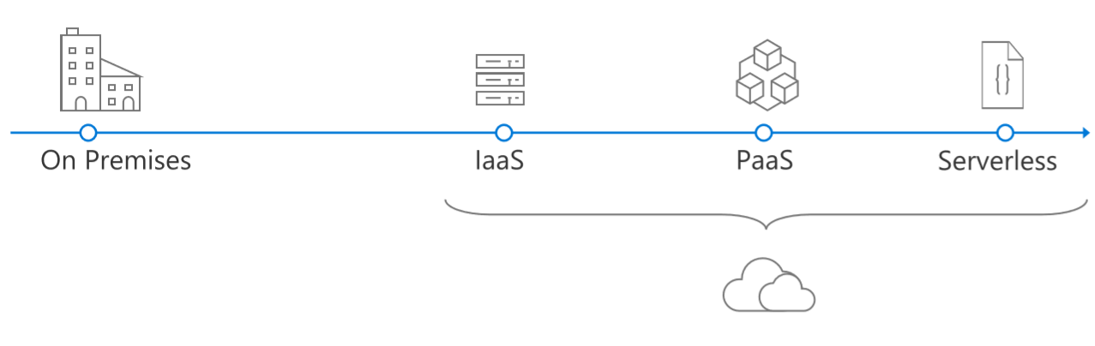
Evolution of Application Platforms

Slide 3
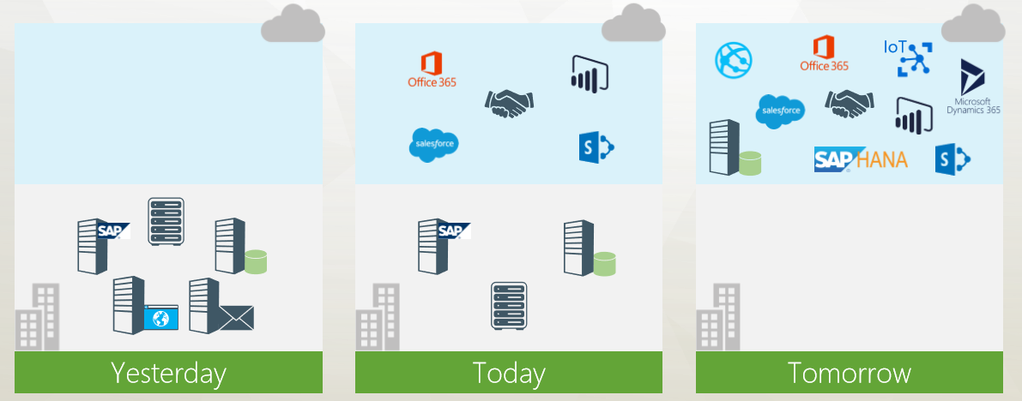
Application Scenario

Slide 4
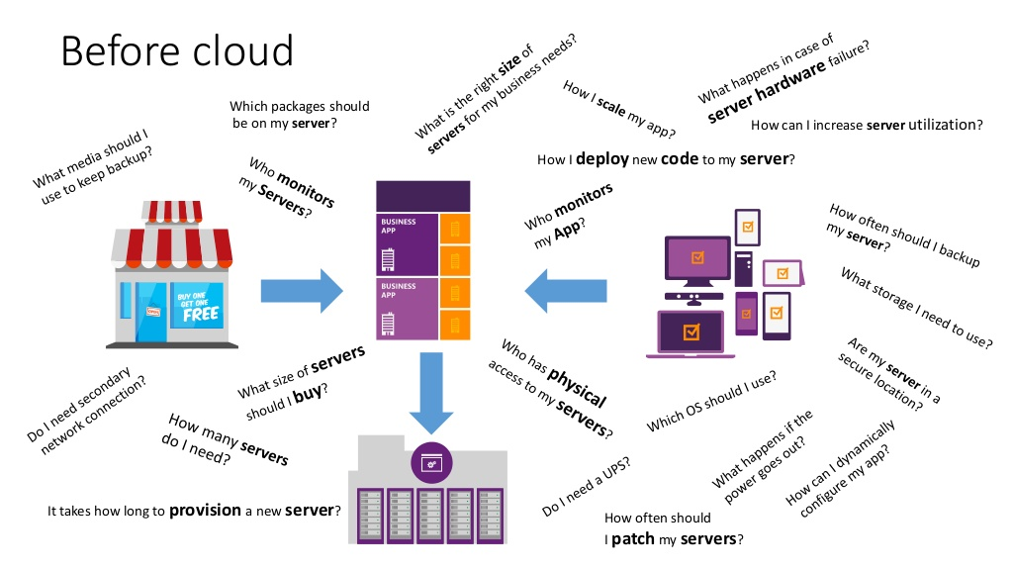

Slide 5
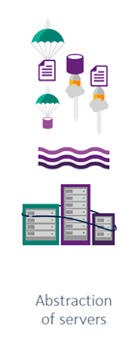
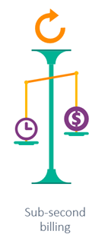
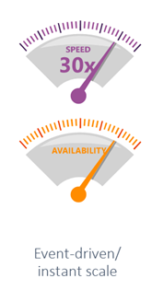
Serverless
No Servers
Not Really?
It does not mean there are no servers involved.
It just means you aren’t managing servers
5

Slide 6

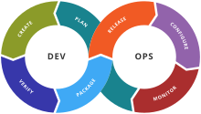

Why Serverless is great?

Slide 7
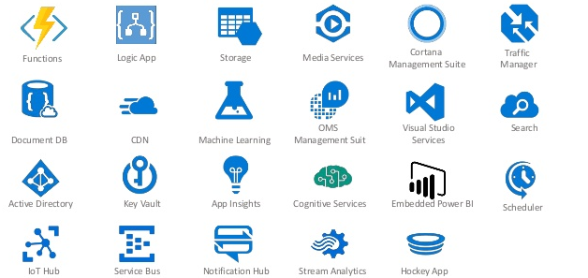
Microsoft Serverless Services

Slide 8
Azure Logic Apps
Alagunila Meganathan
Founder & CEO- InnovoTree Technologies Microsoft MVP
NilaMeganathan

Slide 9
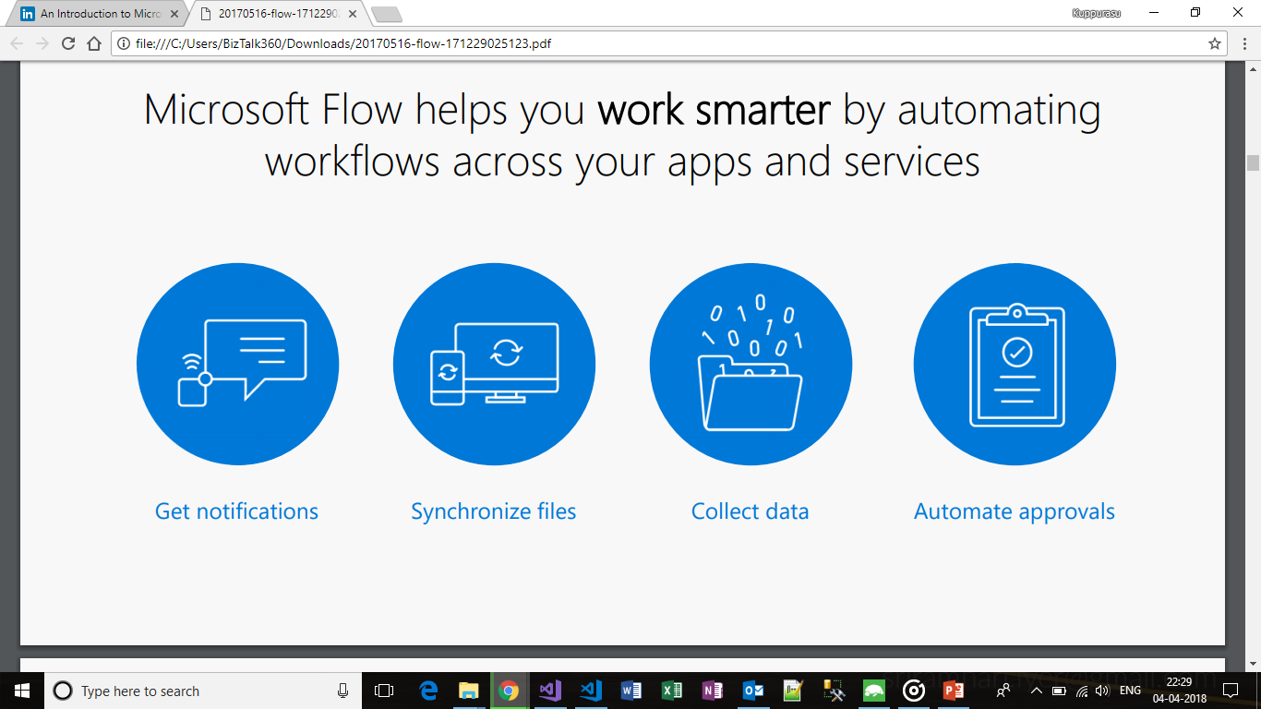
Introduction
Logic App helps us work smarter by automating workflows across our favorite apps and services

Slide 10
Continued..
No code designer for rapid creation
Use with custom API apps of your own
Custom APIs and connectors you can extend into your own applications

Slide 11
Templates
It has predefined templates that you can use to quickly automate and get started. Templates are available for work with:
Approval
Button
Collect data
Email
Events and calendar
Mobile
Notifications
Productivity
Social Media
Sync

Slide 12
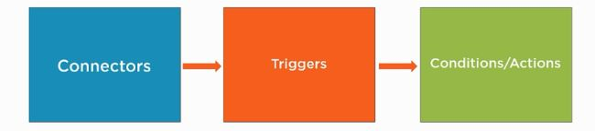
Workflow of Azure Logic Apps

Slide 13
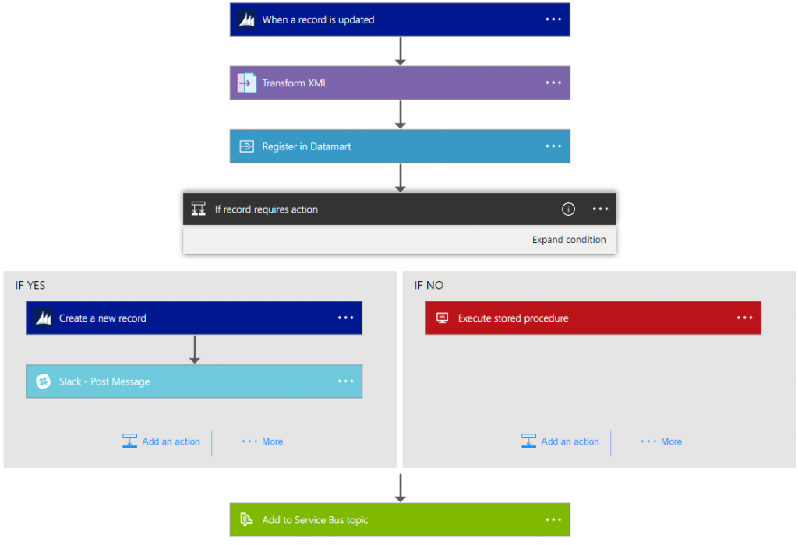
Continued..

Slide 14
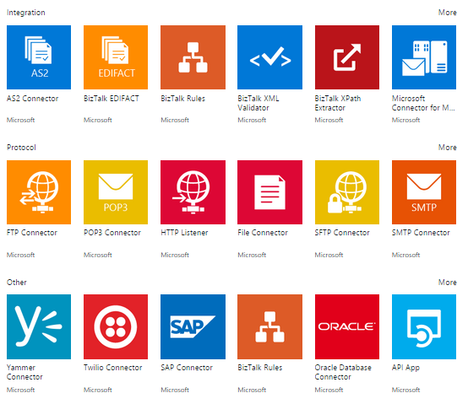
Logic apps connectors

Slide 15
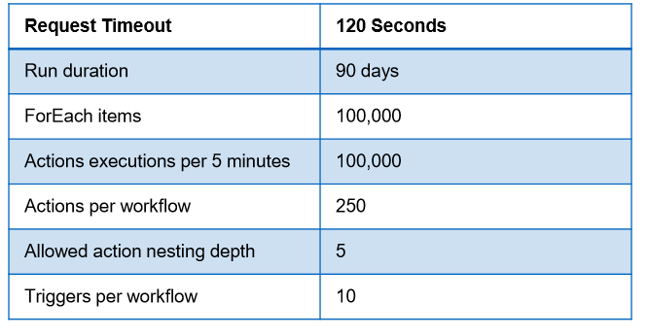
Limits

Slide 16
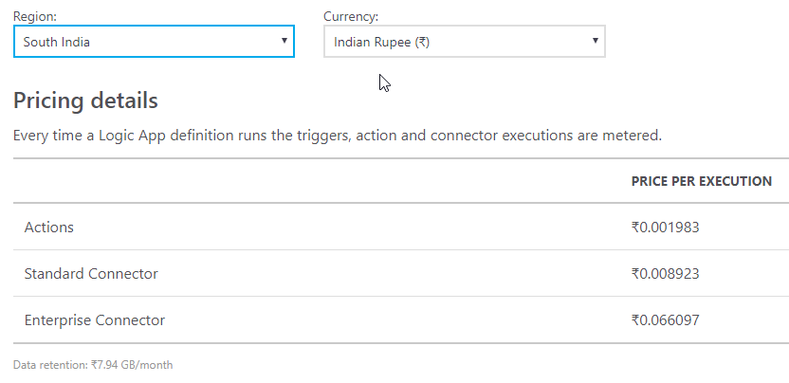
Pricing

Slide 17
Pros
Inbuilt Connectors
Extensibility
Integration
DevOps Support
Notes:
Inbuilt Connectors - There are plenty of inbuilt connectors, triggers and actions that cover many of the common business scenarios. An example is performing sentiment analysis for a topic on Twitter.
Extensibility - If the list of connectors do not meet your need, you can create your own custom APIs, Azure Functions and integrate them to the workflow.
Integration - You can connect disparate systems together. You can integrate your on-premise legacy systems with the new ones in the cloud. Also, you can integrate different LogicApps together.
Templates - There are plenty of predefined templates that are available for common business cases, like HTTP Request-Response, that greatly simplify the work of the development team. Templates are the fastest way to get started with the power of LogicApps.
DevOps Support-It supports the continuous integration and continuous deployment methodology.

Slide 18
Demo Syncing your OneDrive and Google Drive

Slide 19


Slide 20



Azure Functions
Kuppurasu Nagaraj
Software Engineer - BizTalk360
Microsoft MVP
kuppurasu360

Slide 21
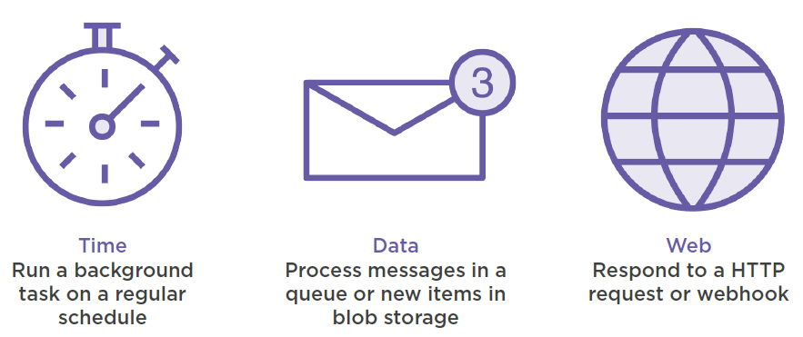
Azure Functions = Events + Code

Slide 22
Why Azure Functions?
Fully managed compute environment
High reliability
Security
Auto-scaling
Pay-per-use (Consumption plan)
Less boilerplate code to write/maintain
Integrate easily with range of services

Slide 23
Type of Functions
Scheduled jobs that run on continuous or triggered schedule
Processing a Http request
Process a message arriving on a Message queue
Run a custom Function manually

Slide 24
Supported Languages
Bash
Batch (really?)
C#
F#
JavaScript
PHP
PowerShell (yay!)
Python

Slide 25
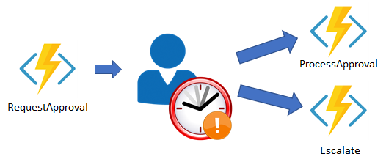
Chaining Azure Functions
Write stateful functions in a serverless environment.

Slide 26
Azure Function Demo – Voting App

Slide 27
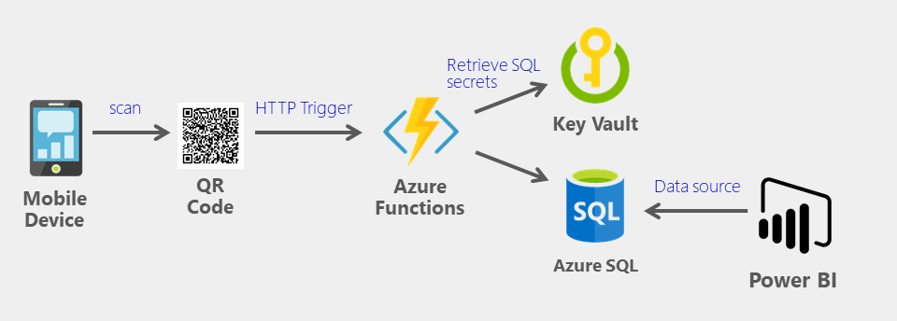

Slide 29


